Slide 1
Can financial statistics explain well stock price?
Present by: Jasming Zeng

Slide 2
Project background and goal
Famous factor that influence stock price: overall market performance, risk-free rate, company news, momentum of the stock market…
Observation: these factors are more or less relative to company financial statistics/ stock price is largely impacted whenever there is a financial report release
Question: Can stock price be explained/forecasted by financial statistics? Or how much can it be explained?

Slide 3
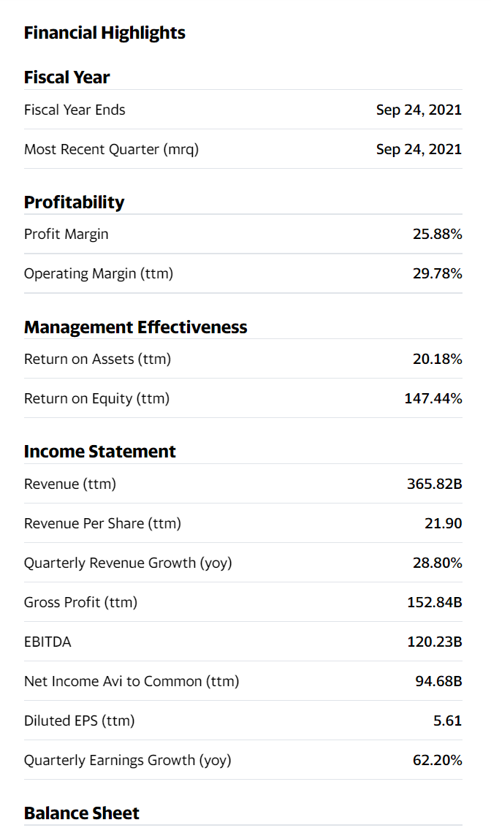
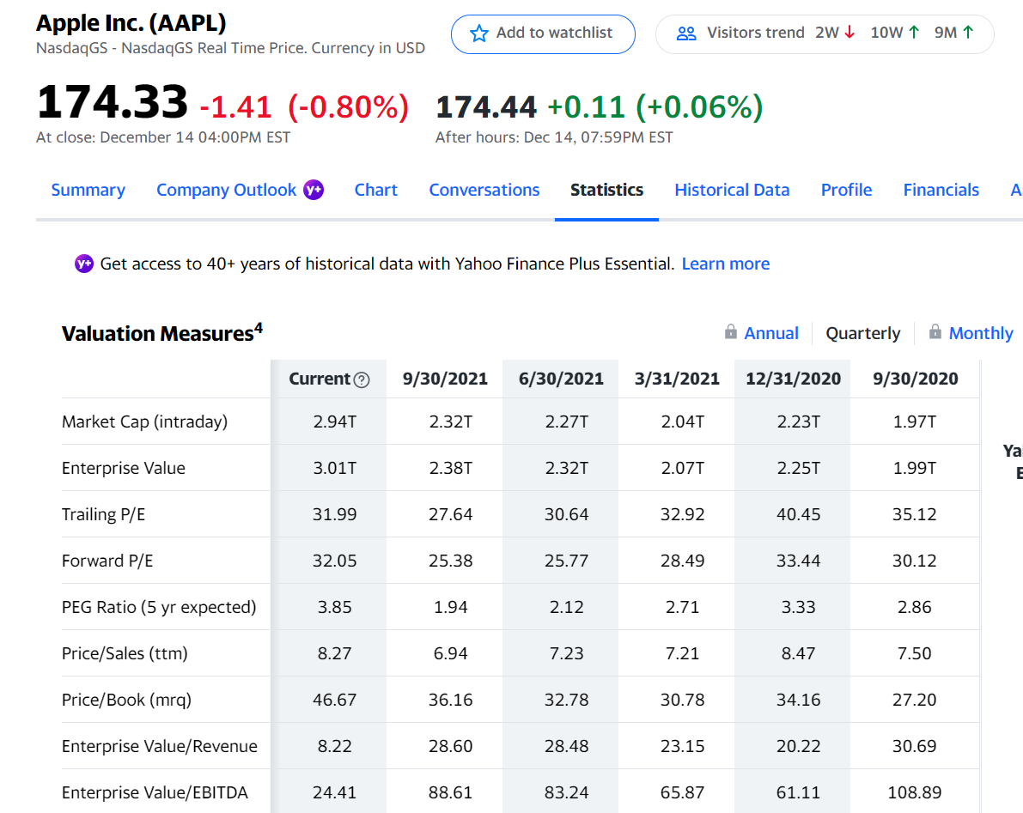
Data for development
Nasdaq listing companies (total 4759 data point)
Web-scraping data from yahoo financetab ‘Statistics’ (29 features)
Data cleaning: Delete 2 features due to large portion of NAs/ Delete rows that contain NA entries. Final list has 1579 data point
Some underlying assumptions:
model applicable to high-tech and growth-oriented company
Only for latest quarterly data point (9/30/2021)
No other factors considered: past stock price/ overall stock market behaviour/ company stakeholders and news of future business plan

Slide 4
Model structure design
1. Linear regression model
2. three features
3. log(stock price) as dependent variable due to linearity pair plot result

Slide 5
Champion model
log(Stock Price) = 0.26*log(Total Cash) + 2.46*Return on Asset + 0.1*log(Total Debt)-3.57
Key statistics
Train set R2 | 0.44
Test set R2 | 0.48
Jarque-Bera P value | 0.52
DW statistics | 2.01

Slide 6
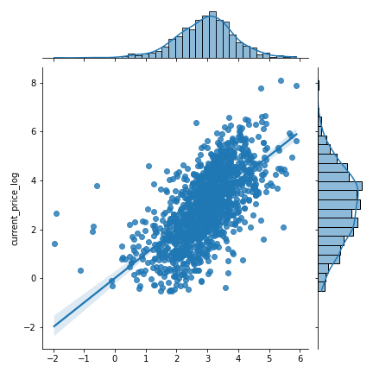
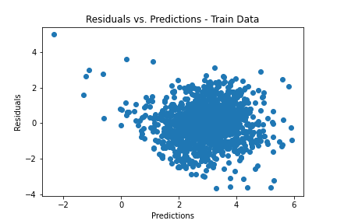
Model fit and residual plot – Train dataset
Fitted vs Actuals
Key observation: although residual passed Jarque-Bera test and DW test. Still, we could observe a trend in the residuals, indicating a missing factor in the model

Slide 7
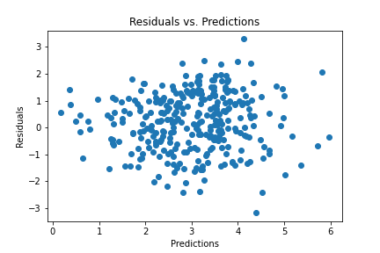
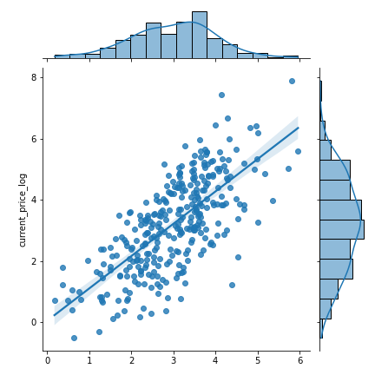
Model fit and residual plot – Test Dataset
Fitted vs Actuals
Key observation: Higher R square in test data comparing to train data, indicating underfit of the model.

Slide 8
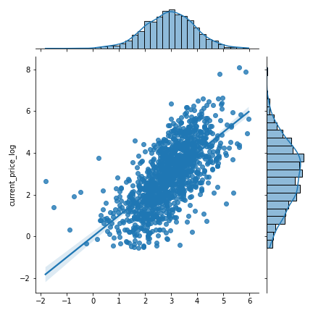
One step further – add a feature
log(Stock Price) = 0.26*log(Total Cash) + 2.15*Return on Asset + 0.1*log(Total Debt)+0.26*Profit Margin -3.53
Observation 1: No improvement in R square (0.44 to 0.44)
Observation 2: No improvement in residual trend
Observation 3: Coefficients of original three variables are stable

Slide 9
Conclusion
If using linear regression to model, stock price could only be forecasted by key financial statistics to a limited level. Obviously, some key features are missed by inspecting the residuals.
Current champion model is stable to forecast the trend, but not dollar amount price, due to the transformation.
Key financial statistics is not very sufficient in predicting stock price.

Slide 10
Thank you! Q&A

